Slide 1
Natural Resources
Chapter 9

Slide 2
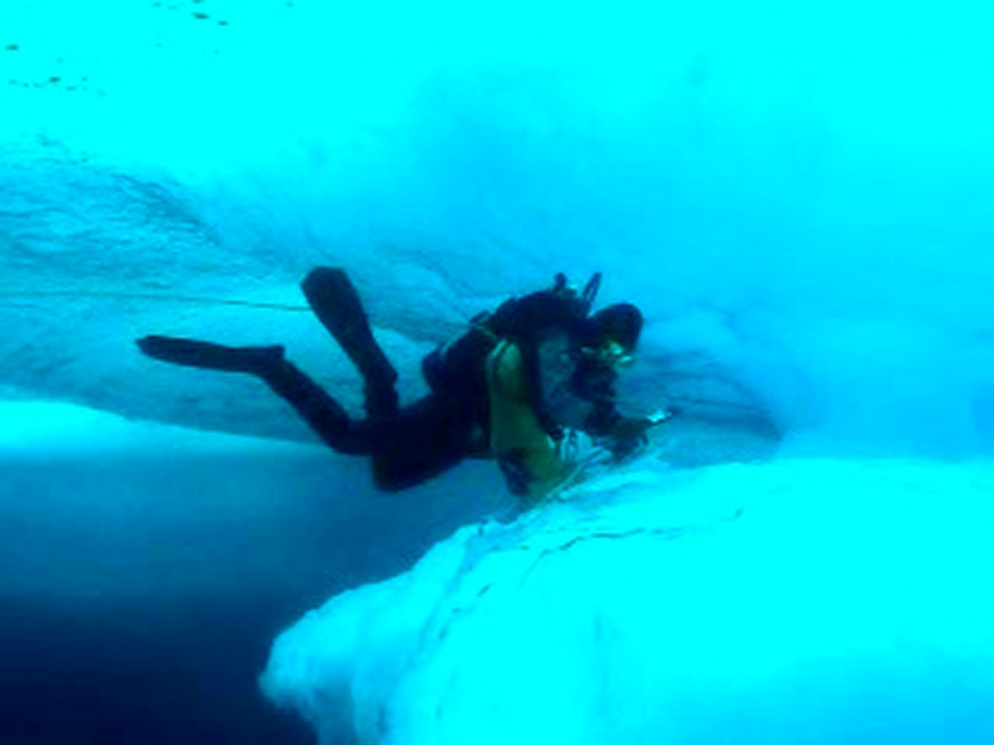
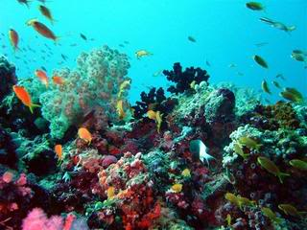
Partner read pg 339
Oceanographer

Slide 3
The Big Question pg. 341

Slide 4
Partner read my planet diary pg 344

Slide 5
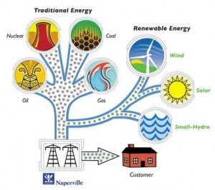
Energy Resources
A resource is something that will meet a need.
Energy resource = meets an energy need
Example; the sun
Sun gives energy like light and heat
People use light to make electricity

Slide 6
Another example
Trees are an energy resource
Trees provide wood
Wood produces heat when burns
Heats homes

Slide 7
Different kinds of energy resources
There are different kinds of energy resources.
Renewable, nonrenewable, and inexhaustible; these are three major types of natural resources

Slide 8
Partner read pg 345 and answer question 1

Slide 9
Partner read pg 345 and answer question 1
Answers.

Slide 10
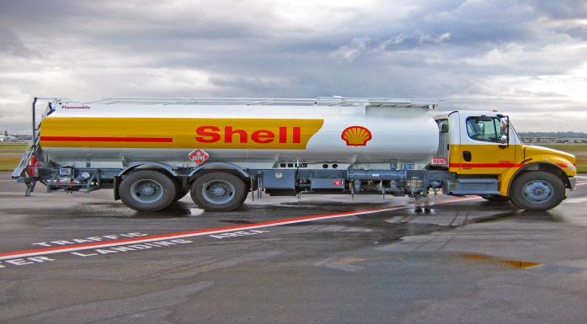
Renewable and Inexhaustible Resources
Resources that can be replaced are renewable resources.
Examples; wood from trees, leaves, food wastes, and even manure.
Group of fuels called biomass fuels,
Made by living things or from recently living things, such as corn.

Slide 11
Inexhaustible Resources
Sun, wind, moving water, and energy from inside Earth are inexhaustible resources.
Inexhaustible Resources will not run out

Slide 12
Partner read pg 346 answer questions 1 and 2

Slide 13
Lets read pg 347 together

Slide 14
Nonrenewable Resources
Energy resources that either cannot be replaced at all or cannot be replaced as fast as people use them are nonrenewable resources.
Nuclear energy and fossil fuels are nonrenewable energy sources.

Slide 15
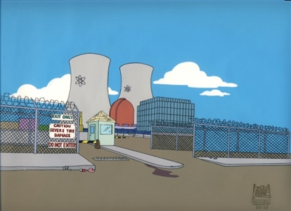
Nuclear Energy
Nuclear power plants often use a metal called uranium to heat water into steam. This steam is used to power generators that produce electricity.
https://www.youtube.com/watch?v=_UwexvaCMWA

Slide 17
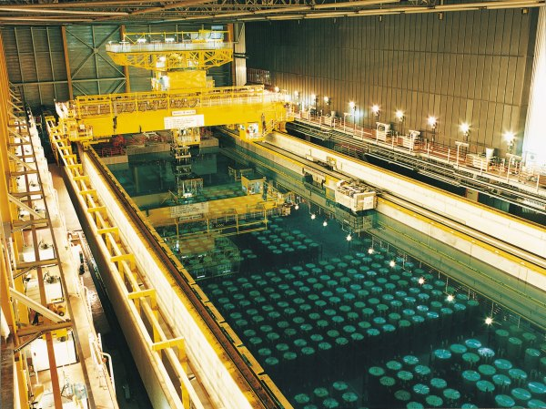
Nuclear Energy
Nuclear power plants do not release pollution into the air. But their wastes are dangerous and must be stored in special places.

Slide 18
Fossil Fuels
Coal, oil, and natural gas are also nonrenewable energy sources.
They are called fossil fuels because they are made from the remains of organisms that lived long ago.

Slide 19
Fossil Fuels
Coal forms from plants. See page 348
Go to tb page 348 and get out a highlighter.

Slide 20
Lesson 2
Do the envision it question on pg 350-351

Slide 21
Pollutants
Pollutants harms natural resources.
A pollutant is an unwanted substance added to the water, air, or soil.
Pollutants result in pollution.

Slide 22
Pollutants
Sources of pollutants may be natural such as, a volcanic eruption.
People may also be sources of pollutants
Chemicals that people use to kill insects and weeds may harm other organisms

Slide 23
Pollutants in Air
Some air pollution is caused by volcanoes and forest fires, which add ash and dust to the air.
Cars and coal- burning power plants release harmful chemicals into the air

Slide 24
Pollutants in Water
Water is sometimes polluted by factories that dump harmful chemicals into rivers, lakes, and oceans. These chemicals can harm or kill fish and other plants and animals that live in the water.
Also if an oil tanker leaks

Slide 25
Pollutants in Soil
Soil becomes polluted by garbage, litter, and other solid waste.
Garbage dump vs. Garbage landfill see pg 353
Litter is when people throw trash and garbage onto the ground. This can be harmful to many animals and spread germs.

Slide 26
Time to Highlight it!!!!!!!!!!!!!!!!!!!

