Slide 1
Chapter 6

Slide 2
Read the My Planet Diary on pg. 194

Slide 3
What are the functions of Roots, Stems, and Leaves?
All the parts of plants serve a function.
Roots, stems, and leaves are three basic structures of plants that we will look into.

Slide 4
What are the functions of Roots, Stems, and Leaves? Roots
Roots are the anchors of plants.
Roots have three main functions
Roots anchor a plant in the ground, absorb water and minerals from the soil, and sometimes store food.
Therefore, the more root area a plant has, the more water and minerals it can absorb.

Slide 5
Different types of Root? Whattttttttt?????
There are two main types of root systems (shown on figure 1). A fibrous root system and a taproot system.

Slide 6
Different types of Root? Whattttttttt?????
Fibrous; consists of many similarly sized roots that form a dense, tangled mass. Plants with this system takes a lot of soil with them (i.e. grass, corn, and onions).
Taproot; has a long thick main root; hard to pull out of the ground. Many smaller roots branch off. I.E. carrots, dandelions, and cacti.

Slide 7
Partner Read pg 195 and answer the figure 2 question

Slide 8
Stems
Has two main functions.
The stem carries substances between the plant’s roots and leaves. The stem also provides support for the plant and holds up the leaves so they are exposed to the sun.

Slide 9
Stems
Herbaceous and woody stems consist of phoelm and xylem tissue as well as many other supporting cells.
Cambium divides to produce new phloem and xylem. It is xylem that makes up “wood.” sapwood is active xylem that transports water and minerals through the stem. The older darker, heartwood is inactive but provides support.

Slide 10
Partner read pgs 196-197 answer the figure 3 and apply it questions.

Slide 11
Stems
Stems can be either woody or herbaceous.
Woody stems are hard and rigid, such as in maple trees.
Herbaceous stems contain no wood and are often soft.
Plants with herbaceous stems include daisies, ivy, and asparagus

Slide 12
Pg 198-199 in text notes

Slide 13
Plants pg202

Slide 14
Plants: The Buds
Buds are responsible for plant growth. Buds can either be new stems, leaves, or flowers.
Buds are three parts:
Main terminal bud- The bud in charge of the upward growth of the plant.
Secondary terminal buds- Come from secondary stems, they make the secondary stems grow.

Slide 15
Plants: The Buds
3) Lateral buds- Are on the stem nodes, leaves and flowers grown from them.
We do eat buds from plants-
Artichokes
Cabbage

Slide 16
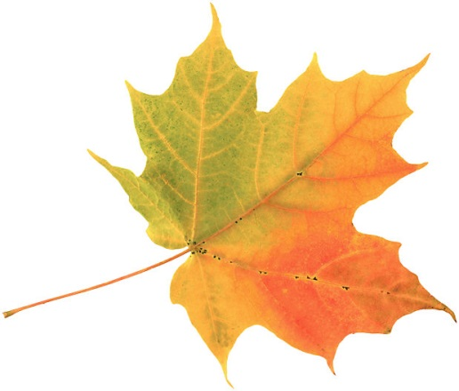
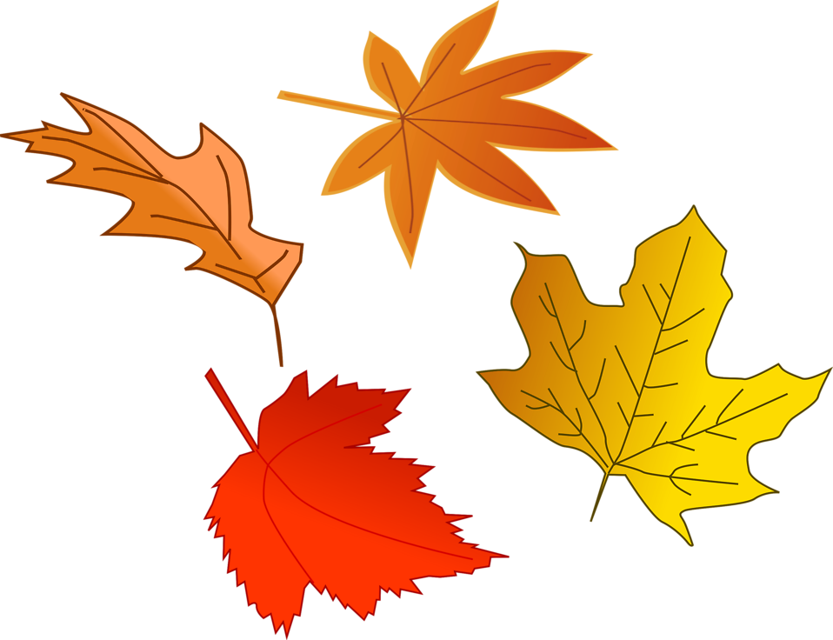
Plants: The Leaves
The leaves are probably the most important aspect of the plant, because they are in charge of photosynthesis.
There are many different sizes and shapes of leaves but leaves tend to have the same parts.

Slide 17
Plants: The Leaves
1) The Blade- The expanded part of the leaf. When people think of a leaf or draw a leaf it is usually the blade.
Veins- Wrinkles or pipes in the leaves, the central vein is called the midrib.
2) The Petiole- Connects the stem to the blade. Not every leaf has a petiole and are called stalk less.

Slide 18
Plants: The Seeds
Seeds are necessary for some plants to reproduce.
Each seed has several parts:
Embryo- the little plant
Endosperm- food supply in the seed
Seed Coat- outer layer of the seed

Slide 19
Plants: The Seeds
Inside a seed is a partially developed plant. If a seed lands in an area where conditions are favorable, the plant sprouts out of the seed and begins to grow.

Slide 20
Seed Structure
A seed has three main parts – an embryo, stored food, and a seed coat.
The young plant that develops from the zygote, or fertilized egg, is called the embryo.
The embryo already has the beginnings of roots, stems, and leaves.

Slide 21
Seed Structure
The outer covering of a seed is called the seed coat.
The seed coat acts like plastic wrap, protecting the embryo and its food from drying out.

Slide 22
Seed dispersal
After seeds form, they are usually scattered.
The scattering of seeds is called seed dispersal. Seeds can be dispersed in many different ways.
Animals digestive system
Enclosed barb like structures that attach to things
Seeds that fall
Water dispersal
Plant ejection.

Slide 23
Germination
After a seed is dispersed, it may remain inactive for a while before it germinates.
Germination occurs when the embryo begins to grow again and pushes out of the seed.
Germination begins when the seed absorbs water. Then the embryo uses stored food to begin to grow.

Slide 24
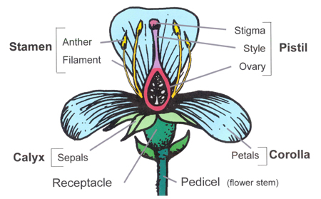
What are the structures of a flower?
A flower is the reproductive structure of an angiosperm (flowering plant).
A typical flower contains sepals, petals, stamens, and pistils.

Slide 26
What are the structures of a flower?
The colors and shapes of most flower structures and the scents produced by most flower attract insects and other animals.
These organisms ensure that pollination occurs.
Pollination is the transfer of pollen from male reproductive structures to female reproductive structures.

Slide 27
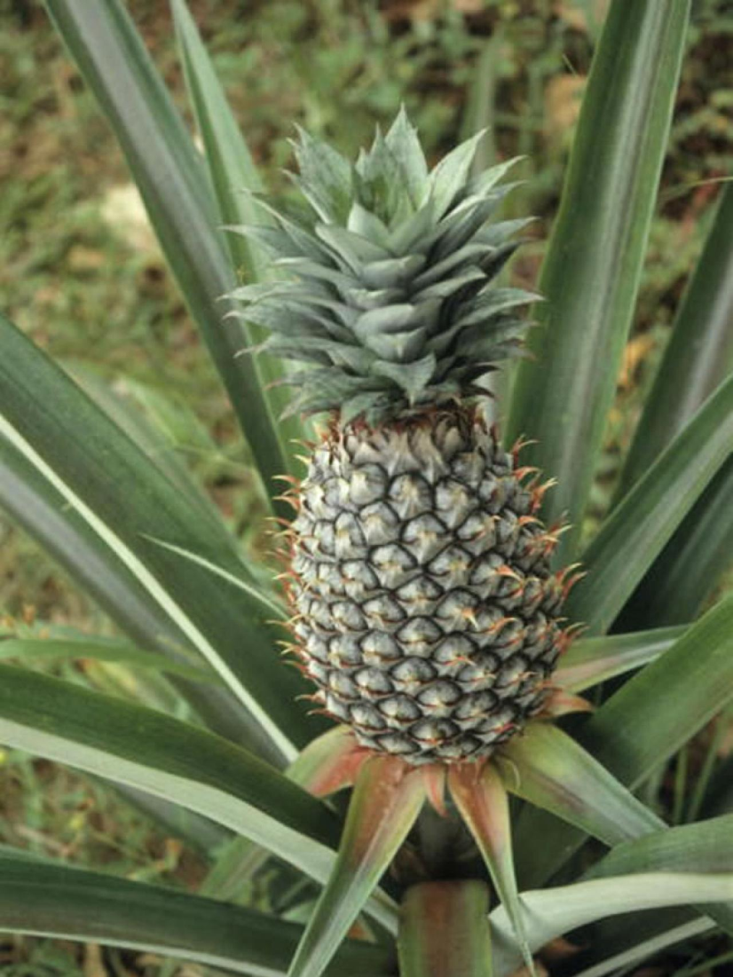
In class textbook notes pg 202-203
Please write In class textbook notes pg 202-203

Slide 28
Lesson 2: What are the stages of a Plant’s Life Cycle
Like other living things, plants develop and reproduce through life stages.
Plants have complex life cycles that include two different stages, the sporophyte stage and the gametophyte stage.
In the sporophyte stage, the plant produces spores or seeds, tiny cells that can grow into new organisms.

Slide 29
What are the stages of a Plant’s Life Cycle
The spore develops into the plant’s other stage, called the gametophyte.
In the gametophyte stage, the plant produces two kinds of sex cells; sperm cells and egg cells.

Slide 30
Plant life cycle
Angiosperms (a flowering plant) are classified based on the length of their life cycles.
Flowering plants:
One growing season life cycle; annuals
Two year life cycle; biennials
Lives for more than two years; perennials
Most perennials flower every year

Slide 31
How do plants reproduce
All plants undergo sexual reproduction that involves fertilization.
Fertilization occurs when a sperm cell unites with an egg cell
The fertilized egg is called a zygote.

Slide 32
Partner read 206
Answer the figure 2 question

Slide 33
How do plants reproduce con’d
Many plants can also undergo asexual reproduction. However, asexual reproduction can reproduce unfavorable traits since there is no new genetic information being passed to offspring.
Scientists can take advantage of asexual reproduction in plants

Slide 34
Nonvascular and seedless vascular plants.
207

Slide 35
Gymnosperms
Gymnosperms (“naked seed”)- cone bearing plants are gymnosperms.
Pinophyta - Conifers
Ginkgophyta - Ginkgo
Cycadophyta - Cycads
Gnetophyta - Gnetum, Ephedra, Welwitschia

Slide 36
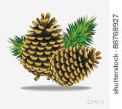
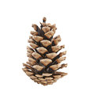
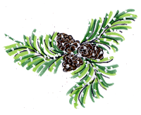
Gymnosperms process of reproduction pg. 209
Step 1; Cone production
Most gymnosperms have reproductive structures called cones. Cones are covered with scales
A few gymnosperms produce no cones.

Slide 37
Gymnosperms process of reproduction con’d
Step 2; Pollen production and Ovule development
Male cones produce pollen grains.
The female gametophyte develops ovules.
An ovule is a structure that contains an egg cell. The ovule later develops into the seed

Slide 38
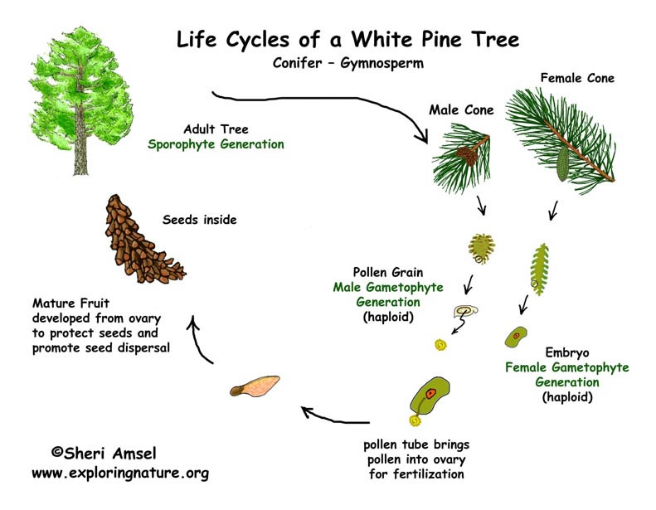
Gymnosperms process of reproduction con’d
Step 3; Egg production – two egg cells form inside each ovule on the female cone
Step 4; Pollination – the pollen collects in a sticky substance produced by each ovule.
Step 5; Fertilization occurs
Step 6; Seeds develop
Step 7; Seed dispersal

Slide 39
Partner read pgs 208-209

Slide 40
Angiosperms
Plants that produce flowers or fruits are called angiosperms (“flowering plants”).
Most species on the planet are angiosperms.

Slide 41
Angiosperms reproduction Pg210
Pollination Fertilization Fruit development and seed dispersal
A flower is pollinated when a grain of pollen falls on the stigma.
As the seed develops, the ovary changes into a fruit. A fruit is a ripened ovary and other structures that enclose one or more seeds.

Slide 42
Lesson 3 Animal reproduction and fertilization

Slide 43
Lesson 4

Slide 44
Plants: The Seeds
We do eat the seeds or fruits of plants-
Apples
Oranges
Beans
Grains
Nuts
Spices

Slide 45
